Slide 1
Technical SOLUTIONS & Technical problems in primary Care
"All individuals who have received the practical teachings of this manual will, if the text be remembered, be set face to face with the ecstatic radiance and will win illumination instantaneously, without entering upon hallucinatory struggles and without further suffering on the age-long pathway of normal evolution which traverses the various worlds of game existence.”
–Tibetan Book of the Dead
Introducing
Fred Watters, RN, BSN, CCRN
UMaine Graduate School of Nursing

Slide 2

Imagine an overweight, diabetic, cardiac patient…
…in a few years time.

Slide 3
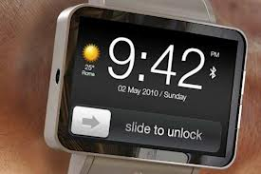
He gets a call on his ‘smart watch’
Informing him an appointment is available
this morning with his Nurse Practitioner…
Would he be available?

Slide 4
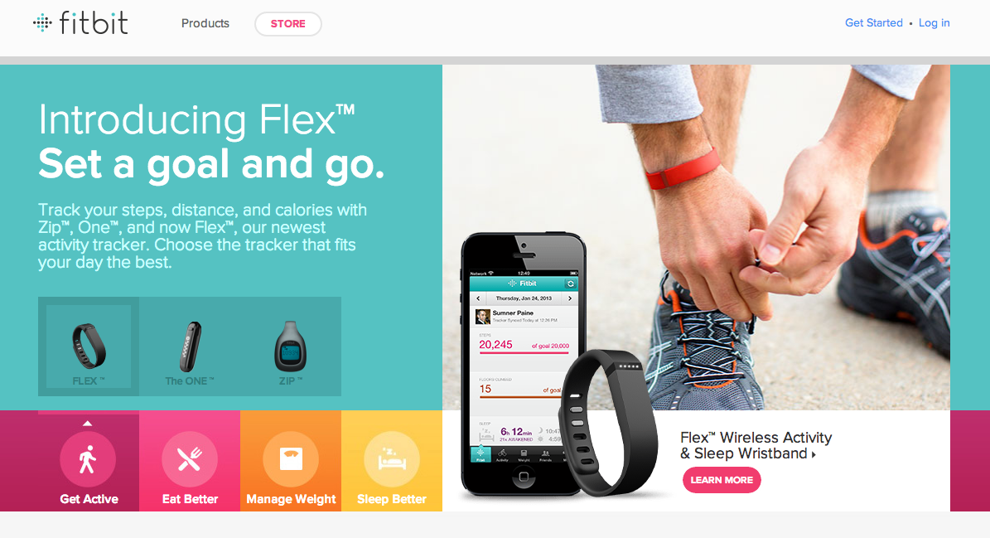
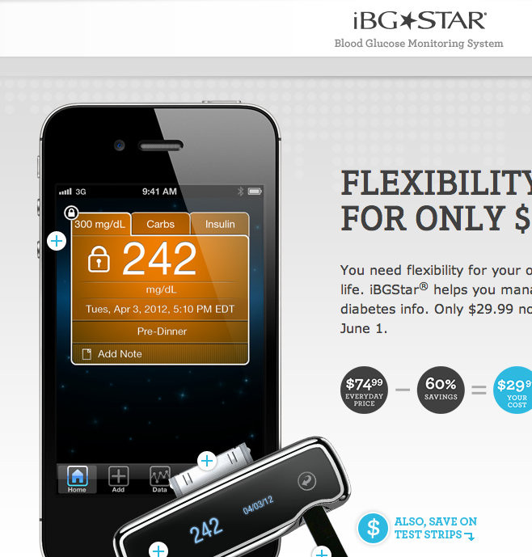
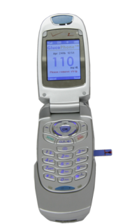
The History now includes… the Download.
Glucose Monitor
App-Assisted Activity Monitor

Slide 5
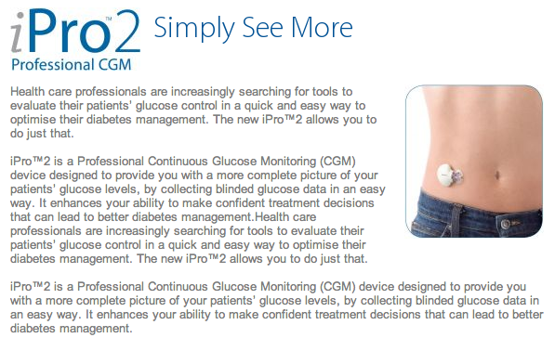
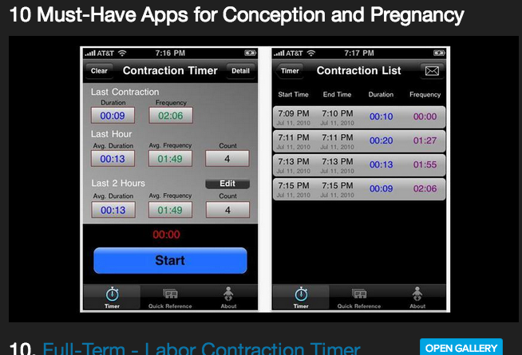
and more Downloads.
Continuous Glucose Monitoring
Home Pregnancy Apps

Slide 6
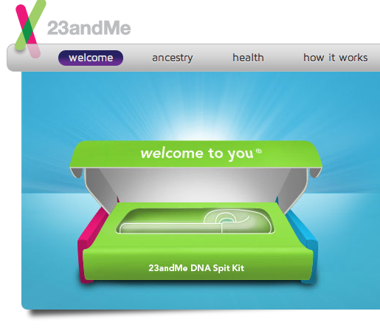
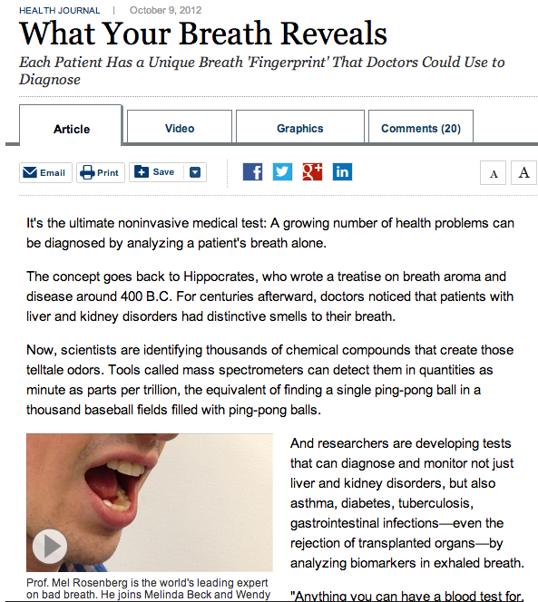
Other History is now available…
Personal Genome Sequencing
Breathalyzer to assess for underlying illness
Breath HERE to Diagnose:
Cancer, Kidney Disease
Diabetes, Tuberculosis,
& GI Infections

Slide 7

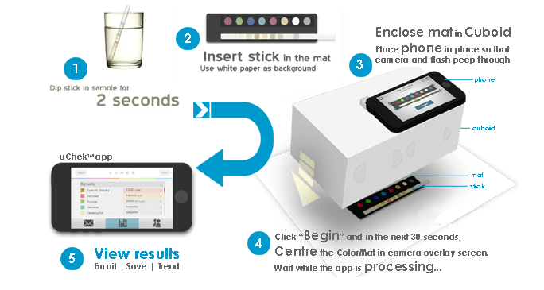

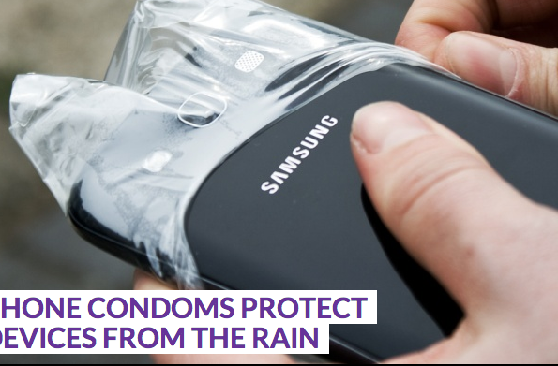

After a careful history... A few tests.
Find a vein for blood testing
Urinalysis by Smartphone
Check to see in your NP
washed their hands!
Don’t worry there’s a condom…

Slide 8
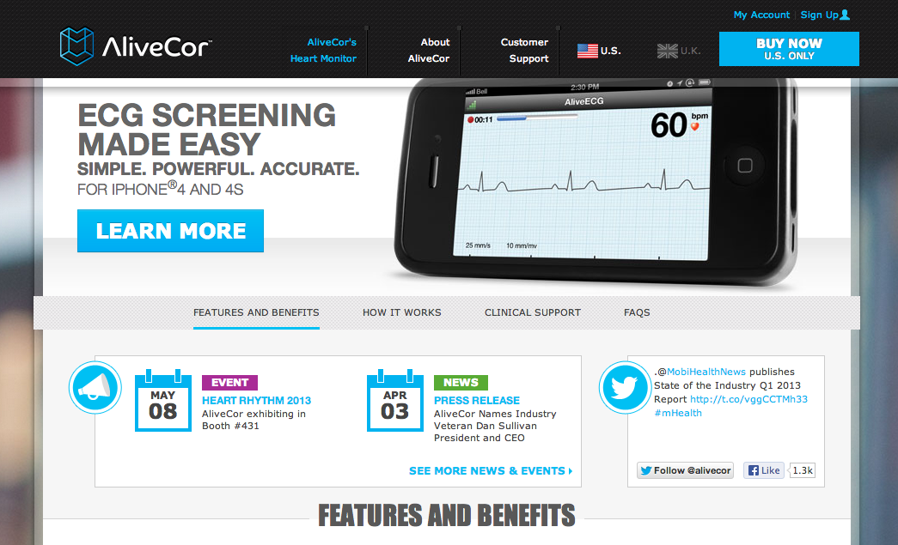
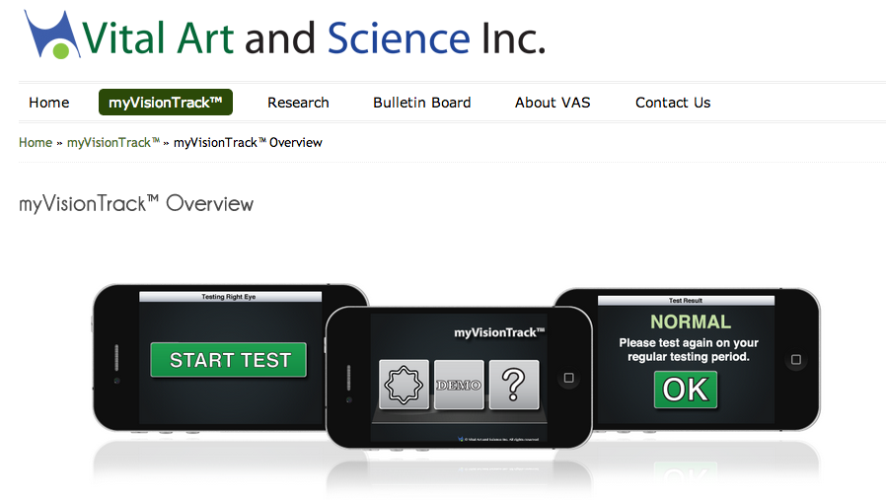
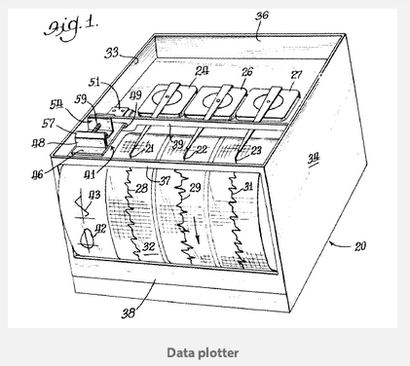
Disease-Focused Apps & Peripherals
FDA Approved Smartphone
EKG
FDA Approved Yearly Diabetic Vision Exam

Slide 9
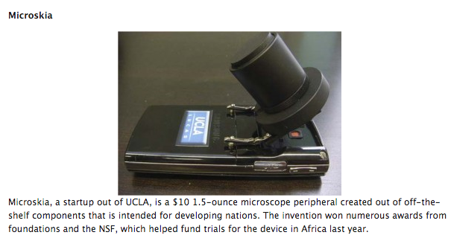
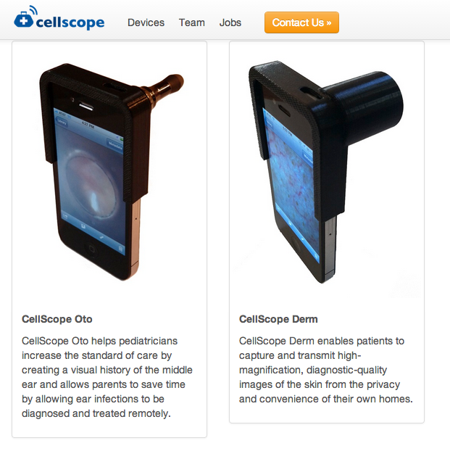
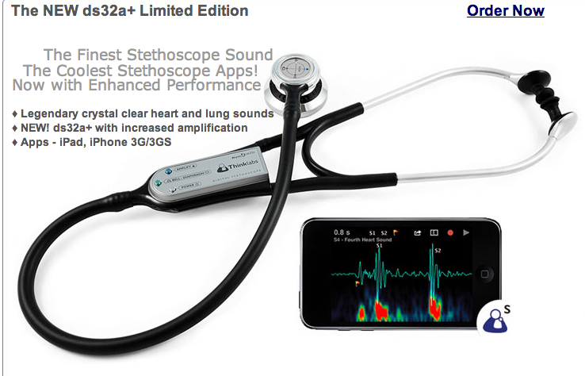
Exam Focused Apps & Peripherals
Microscopic Examination
Otoscopic & Dermatologic Examination
App-Supported Stethoscope

Slide 10
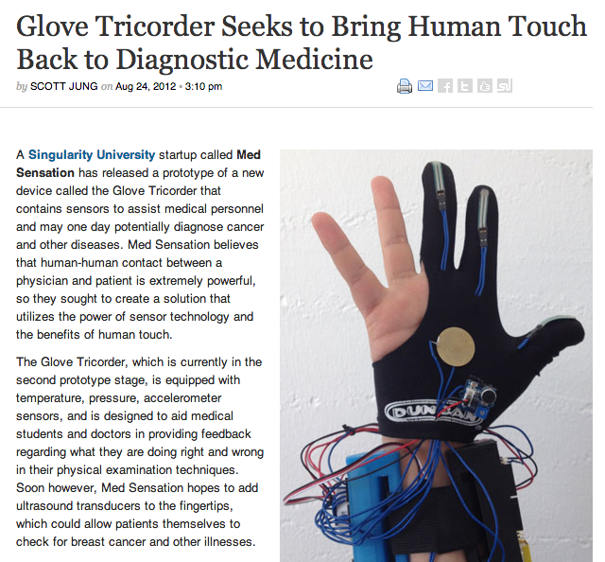
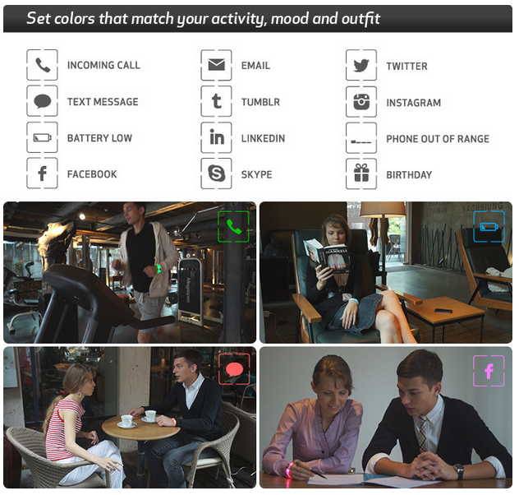
Wearable Tech goes to the next level…
Tricorder Glove
Embrace+
Social Media Communicator

Slide 11
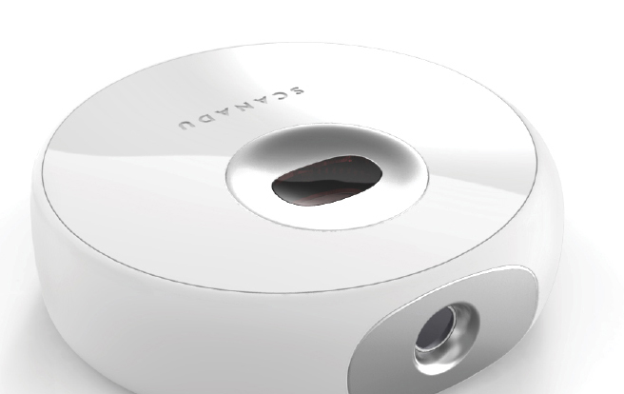
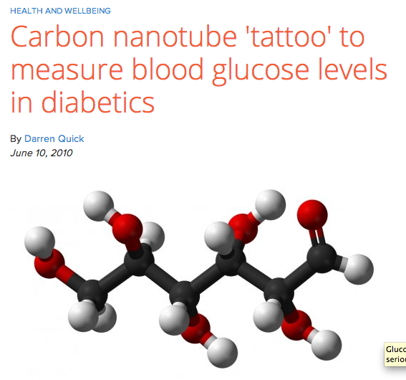
Tech that monitors and communicates
Scanadu Home Diagnostic
Machine-readable Tattoos
For Diabetic Monitoring
Home Vitals and Lab Testing
‘Tricorder’ X-Prize

Slide 12
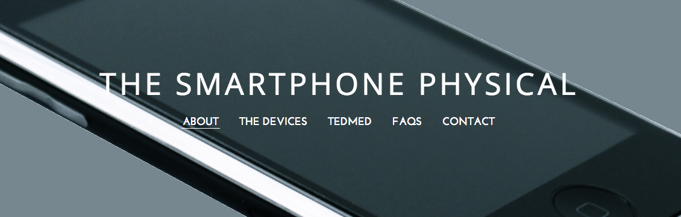
And now back to that cardiac patient…
Featured at TEDMED in Washington D.C. in April

Slide 13
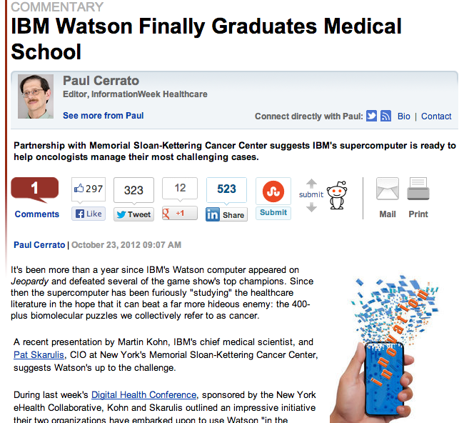
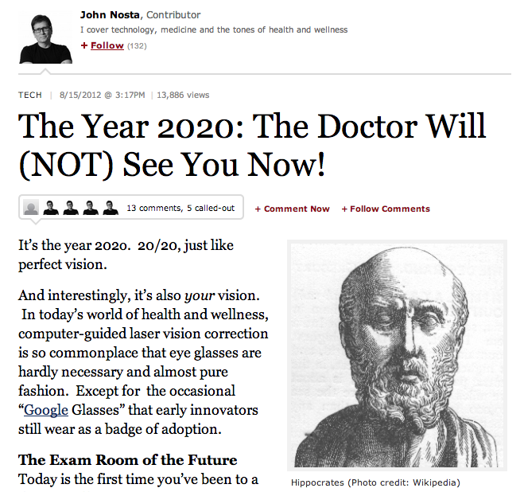
So now…
Things get even weirder…

Slide 14
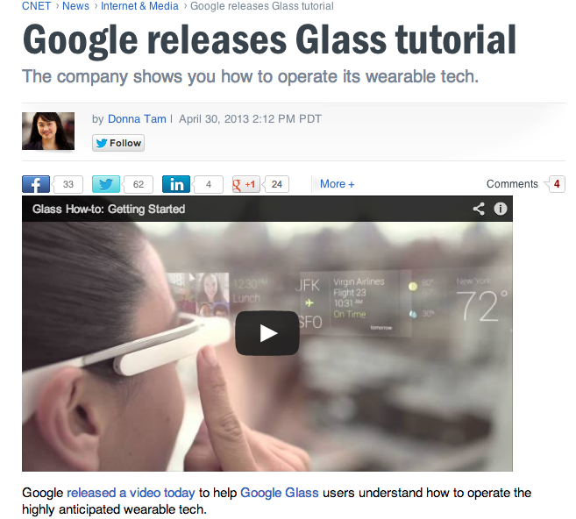


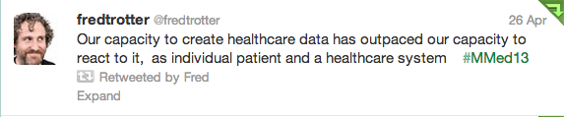
“Ok Glass, Violate HIPAA”

Slide 15
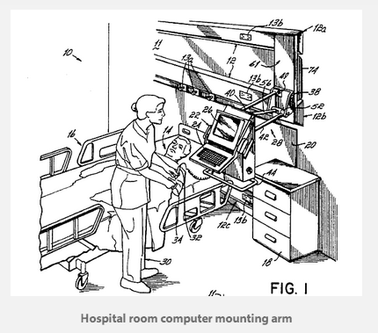
Stop the press!
Are We Nurse Practitioners or Computer Technicians?

Slide 16
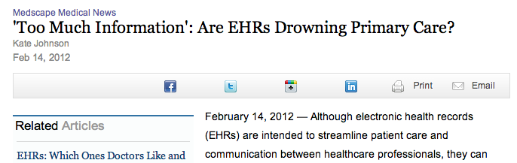
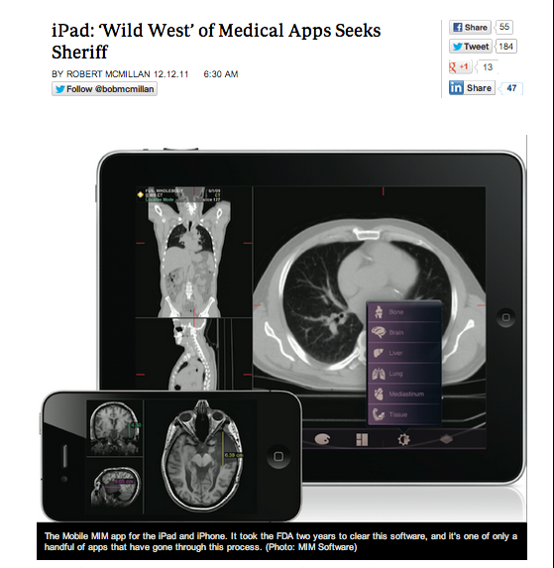

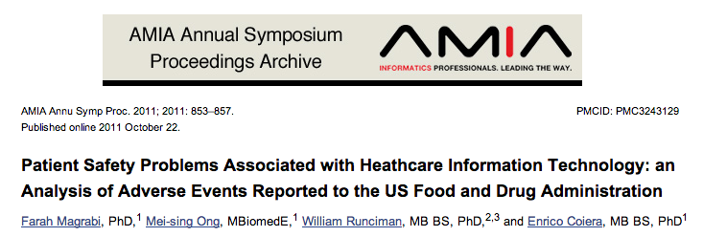
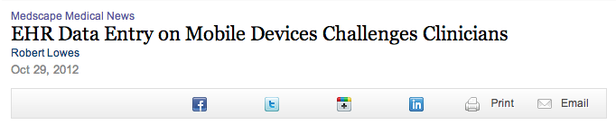
No ONC Statement on mHealth Devices Expected Until October 2013

Slide 17
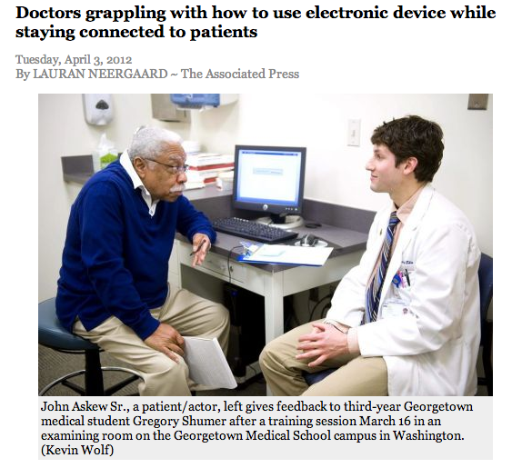

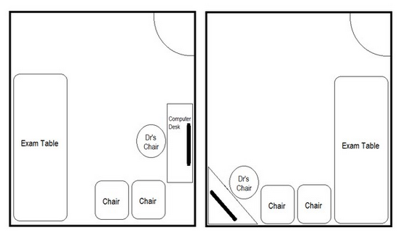
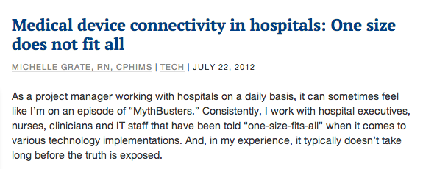
Interoperability is just one aspect of Usability

Slide 18

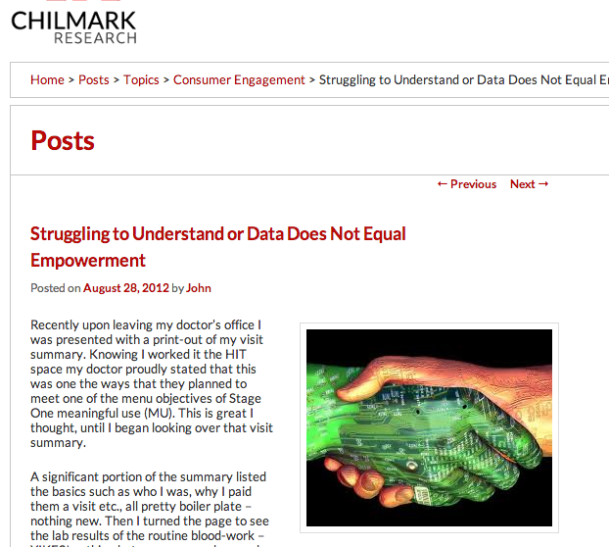

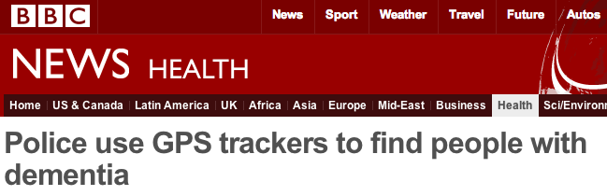
Major Security and Computing Issues
ACO Security Issues

Slide 19
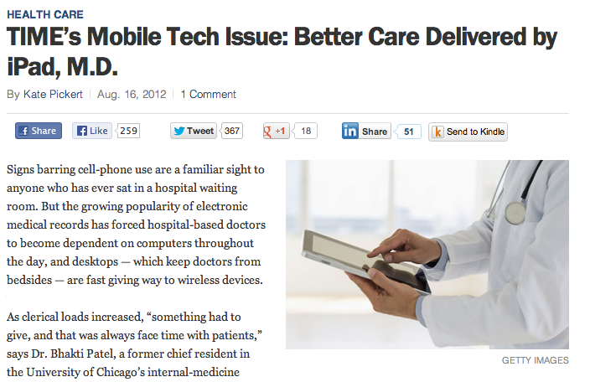
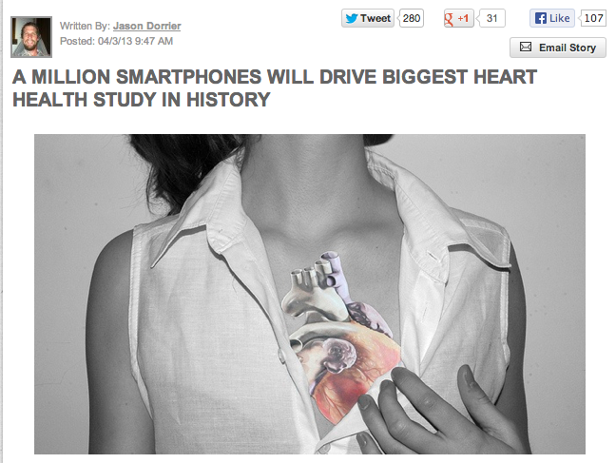
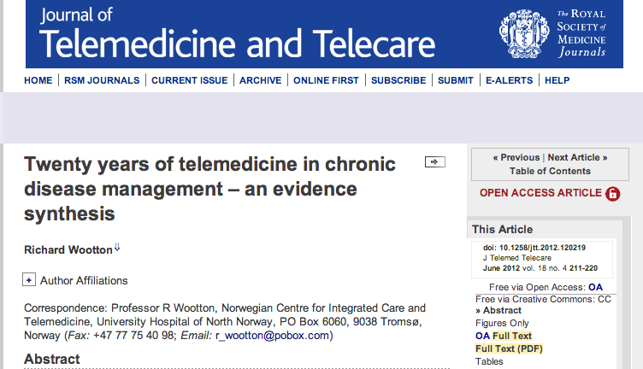
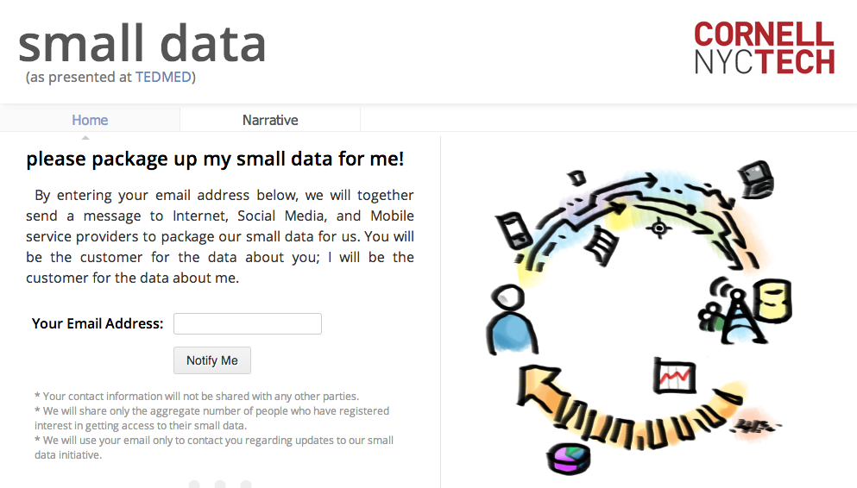
But there are Answers too!

Slide 20

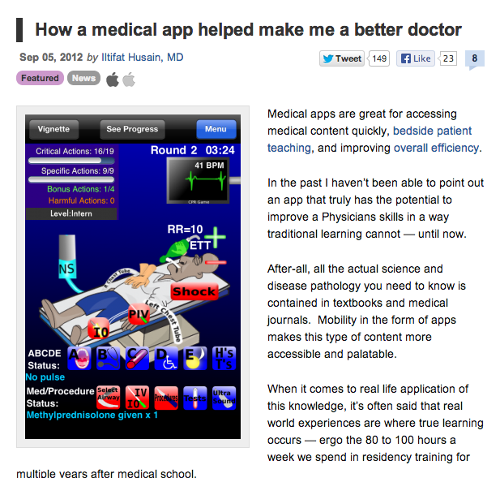
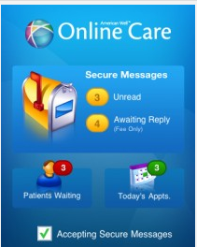
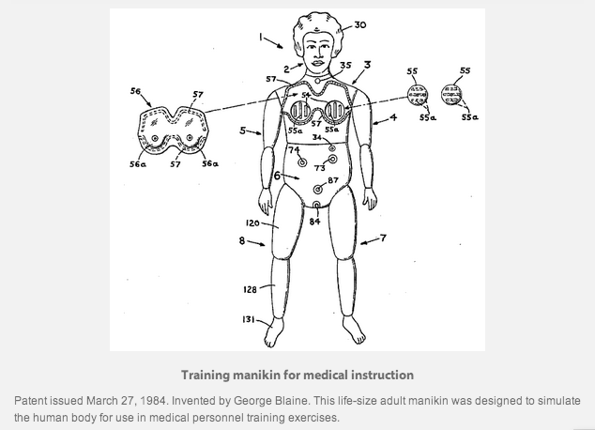
Distributed Delivery & Big Data
E-Patients
VA scraps Co-Pay for Home Health Video Monitoring

Slide 21
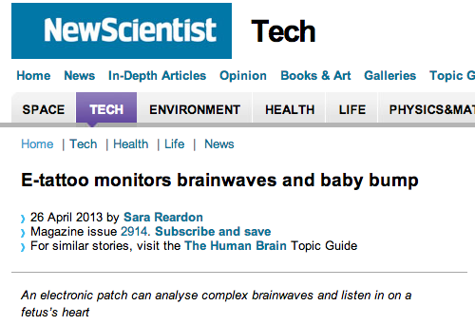
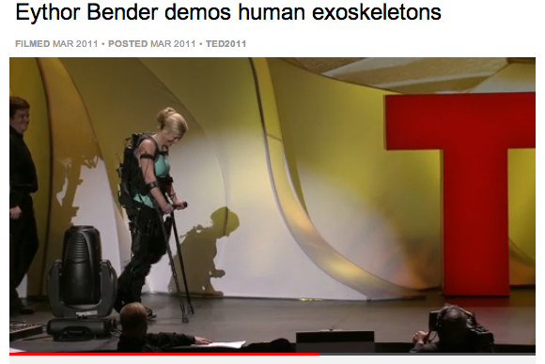
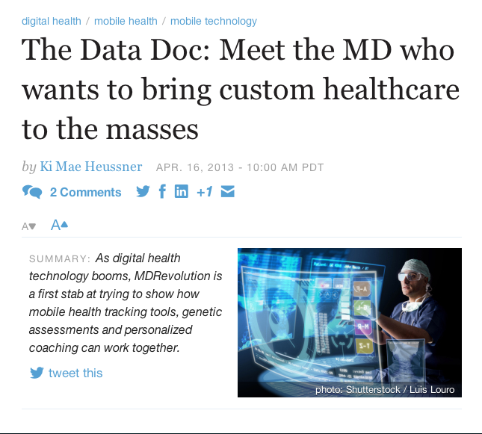


Amazing Innovation is the rule of the day…

Slide 22


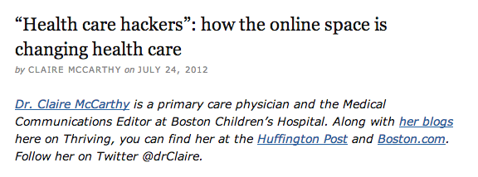
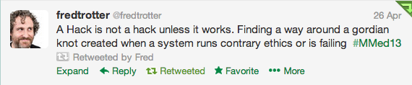
Quantified Self
Engage patients and motivate them to be more active participants in their care.
Facilitate the tracking and management of chronic illnesses.
Contribute to patient understanding of their health.

Slide 23
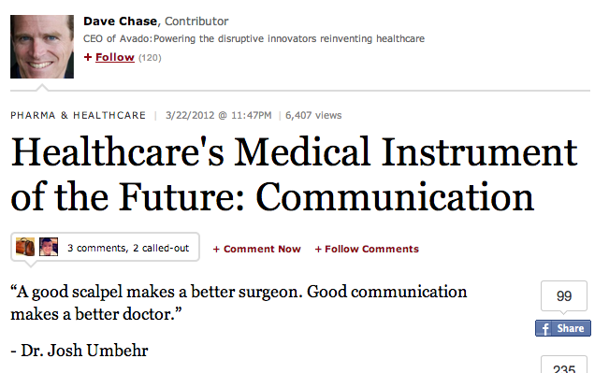
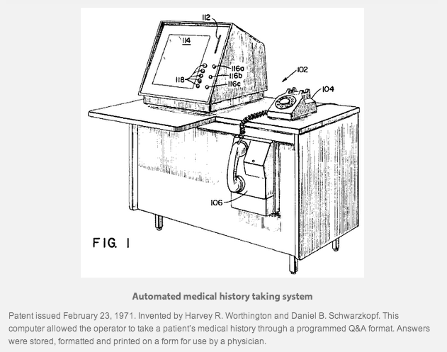


Key Technology = Communication

Slide 24



Our Responsibility as Nurses…

